Slide 1
The role of the family in ethnolinguistic identity: Japanese & Hawaiian language histories
Christina Higgins, Gavin Lamb, & Mónica Vidal
University of Hawai‘i at Mānoa

Slide 2
Research Questions
In the context of Hawai‘i, how do the attitudes expressed towards heritage languages by family members shape individuals’ own language attitudes?
In other words: How do speakers position themselves (identify) in response to their family members’ language attitudes?
How do these language attitudes relate to language maintenance and language shift?

Slide 3
The challenge of research design
How to get a big picture view of LA with insights into LMLS?

Slide 4
Attitude (Appraisal Theory)
Hiss, 2013 – application of Appraisal Theory to Language Attitudes in Norway
Martin & White, 2005; SFL
Affect = evaluation through emotion
I wasn’t really enthusiastic, it was just, just for go school.
Part of the reason he wanted us to take Japanese was we are Japanese.
Judgment = evaluation of people vis-à-vis social norms, systems of value
Oh okay, it’s free edu-, free preschool and learn Hawaiian ae, cool.
I don’t think he thought it was his place to learn Hawaiian.
Appreciation = evaluation of objects through their aesthetic values
I think it’s important. (talking about Japanese)
I just spoke regular English.

Slide 5
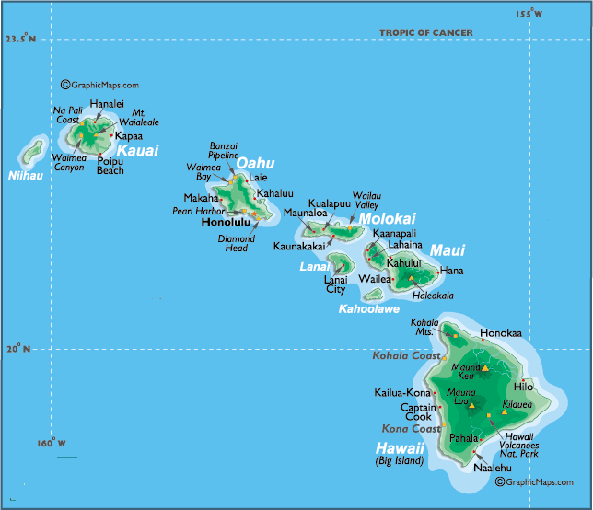
Context of the study
The Hawai‘i Linguistic Family Tree Project
Plantation-era languages
Hawaiian
English
Cantonese
Portuguese
Japanese
Pidgin
Islands
Big Island
Kaua‘i
Maui
Moloka‘i
O‘ahu

Slide 6
Hawaiian-identified participants
Name | Age | Gen | Island | Languages | Languages of past 2 generations
Jaci | 21 | F | Big Island | English, Hawaiian, Japanese, Korean, Pidgin | Cantonese, English, Hawaiian, Japanese, Pidgin
Tasha | 43 | F | Big Island | English, Pidgin, Hawaiian | English, Pidgin, Hawaiian
Moana | 53 | F | Big Island | English, Pidgin | English, Hawaiian, Pidgin
Gina | 20 | F | Maui | English, Hawaiian, Pidgin, Samoan, Spanish | Cantonese, English, Hawaiian, Japanese, Pidgin
George | 63 | M | Maui | English, Hawaiian, Pidgin | English, Hawaiian, Pidgin
Krysta | 20 | F | Molokai | English, Hawaiian, Pidgin, Moke | English, Hawaiian, Ilocano, Pidgin
Pualei | 21 | F | Moloka’i | English, Hawaiian, Pidgin | English, Hawaiian, Pidgin
Jim | 19 | M | Oahu | English, Hawaiian, Pidgin | Cantonese, English, Filipino, Hawaiian, Pidgin
Kathy | 21 | F | Oahu | English, Hawaiian, PIdgin | English, Hawaiian, Japanese, Pidgin
Kaleo | 42 | M | Oahu | English, Hawaiian, Pidgin | English, Hawaiian, Japanese, Pidgin
Notes:
Here is an overview of the 10 Hawaiian identified participants we selected for today’s presentation. As you can see, there is a mix of island, age, and gender. The category LANGUAGES refers to the languages that each person claimed some knowledge of in the interview. The right hand column shows the languages of the past 2 generations.

Slide 7
Japanese-identified participants
Name | Age | Gen | Island | Languages | Languages of past 2 gen
Jaci | 21 | F | Big Island | English, Hawaiian, Japanese, Korean, Pidgin | Cantonese, English, Hawaiian, Japanese, Pidgin, Portuguese
Wally | 70 | M | Big Island | English, Pidgin | English, Japanese, Pidgin
Chase | 20 | M | Kauai | English, Japanese, Pidgin | English, Filipino, Hawaiian, Pidgin, Visayan
Laura | 21 | F | Kauai | English, Hawaiian, Pidgin | English, Hawaiian, Japanese, Pidgin
Chad | 42 | M | Kauai | English, Japanese | English, Japanese, Pidgin
Kai | 15 | M | Maui | English, Japanese | English, Pidgin
Lori | 53 | F | Maui | English, Japanese | English, Japanese
Maile | 20 | F | Oahu | English, Pidgin | English, Pidgin, Japanese
Seiya | 22 | M | Oahu | English, Japanese | English, Japanese
Go | 64 | M | Oahu | English, Japanese, Pidgin | English, Japanese, Pidgin
Notes:
Here is the information on our Japanese-identified participants.

Slide 8
Methods
Data Collection
Semi-structured interviews (30-60 minutes)
Active interview (Holstein & Gubrium, 1995)
100 participants representing 5 islands
4 interviewers carried out the data collection
Data Analysis
Selection of 10 Japanese-identified & 10 Hawaiian-identified participants (range of ages, islands)
Coding using Appraisal Theory for global analysis; inter-rater reliability
DA focusing on stancetaking and stance follows and implicit evaluative language outside of the sub-system of attitude

Slide 9
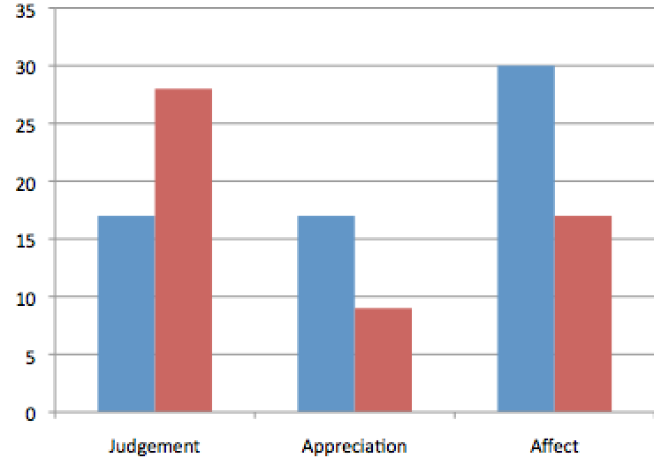
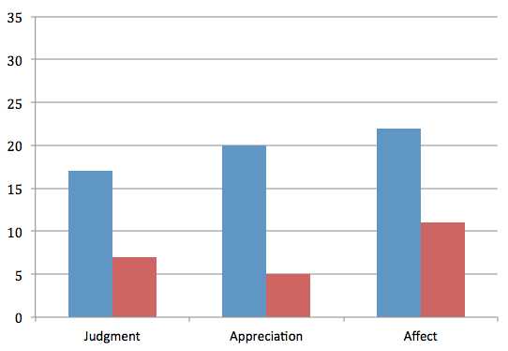
Results of Hawaiian and Japanese appraisals by interviewees
Hawaiian
Japanese
Notes:
Here we first provide a big picture view of language attitudes that came out of our coding of the interviews.
Overall, there are more negative appraisals of Hawaiian compared to Japanese. We think this relates to the more stigmatized status of Hawaiian over the course of time, at least as voiced by the interviewees and their family members. It also suggests that in recounting linguistic family trees, these negative appraisals provided the participants with stance leads which they could then respond to with stance follows. What we suggest is that oftentimes, and particularly for those who are involved in revitalizing the language, the participants disaligned with negative appraisals. A striking result is the high number of negative judgments in relation to Hawaiian, which were arguably countered in some ways with the high number of positive affect.
In contrast, Japanese shows more positive evaluations across the board. Our interpretation of this is that Japanese language abilities are less likely to supplant English as a medium of schooling (as Hawaiian immersion does), and hence attitudes towards Japanese are less controversial. We also believe that Japanese is viewed more positively due to its position in the Asia Pacific region and as an important language linked to a nation with a strong economy.

Slide 10
Language attitudes as stances
How speakers position themselves in talking about intergenerational transmission of language
Stance leads
Stance follows
Notes:
CMH
Of course, the big picture pushes us to consider how these attitudes develop in the first place. Hence, we need to look at the more fleeting nature of attitudes in the form of stancetaking.

Slide 11
JAPANESE
2 CASE STUDIES OF STANCETAKING
Shift
Maintenance
Notes:
GAVIN
First, we look at Japanese, and we examine one case of language shift and one case of language maintenance.

Slide 12
Wally’s family tree
Japanese
Pidgin
English
Japanese
Pidgin
English
Japanese
Japanese
Paternal GF
Paternal GM
Maternal GF
Maternal GM
Japanese
Pidgin
English
Japanese
English
Pidgin
Father
Pidgin
English
Mother
WALLY
Pidgin
English
children

Slide 13
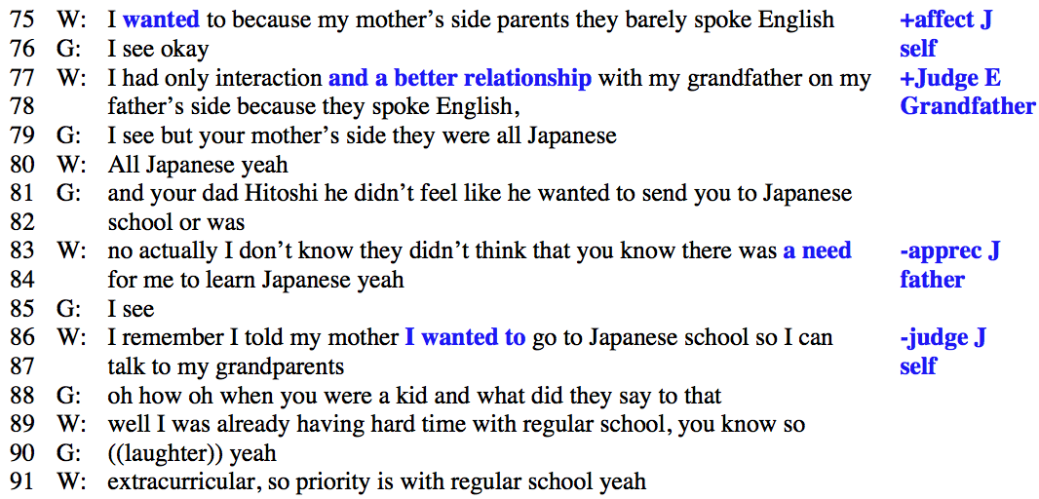
Family stances outweigh individual stances
+affect [J] self
+judg[E] GF
-apprec[J] father
+affect[J] self
Notes:
An example from Wally shows how parents and grandparents’ stances can affect language outcomes despite a desire to learn or maintain Japanese.
Along the right hand side, you can see how appraisals stack up. Wally expresses positive evaluations of Japanese, but his relations with his grandparents are valued positively through English, and his parents failed to appreciate the need for Japanese. Appraisals connected to his parents and grandparents (and presumably, their actions too) outweighed Wally’s desires, and in the end, he did not learn Japanese.
In the excerpt, Wally animates himself as a child, taking a positive stance towards Japanese. One instance of this is when he says (in line 86) “I remember I told my mother wanted to go to Japanese school so I can talk to my grandparents”. Rather than taking up this stance, however, his mother is represented as valuing English at the expense of Japanese. As he explains it in line 89, Wally was having a hard time with “regular school,” and hence, his parents’ stance was that “priority was with regular school.” Since Wally and his parents are Pidgin speakers, it is likely that he struggled with the English-based schooling he experienced, and that this alarmed his parents. This moment in Wally’s linguistic history offers insights into the reasons for language shift.

Slide 14
Wally
Stance lead
“I wanted to go to Japanese school so I can talk to my grandparents”
disalignment
Japanese
“Priority was with regular school”
Stance follow
Wally’s parents
Notes:
The stance triangle shows how Wally’s positive stance towards Japanese (“I wanted to go to Japanese school so I can talk to my grandparents”) is disaligned with by his parents. This is one fleeting stance in Wally’s language history that sheds light on how language attitudes in his family contributed to language shift to English and Pidgin.

Slide 15
Seiya’s family tree
Japanese
Japanese
Japanese
Japanese
Paternal GF
Paternal GM
Maternal GF
Maternal GF
Japanese
limited English
Japanese
limited English
father
mother
English
Japanese
English
Pidgin
Japanese
Older siblings:
English dominant
Some Japanese
Brother (20)
SEIYA
Brother 42, Sister 32, Brother 28
Notes:
Here’s Seiya’s family tree.
One note is that Seiya’s parents live their lives in Japanese, as his father is a sushi chef who serves Japanese customers and works with Japanese speakers. His mother works in a hotel and is similarly surrounded by Japanese.
Despite being the 4th child in the family, Seiya claims to have the best Japanese among his siblings. Much of this is attributed to his interest in the language despite his siblings’ apathy for it.

Slide 16
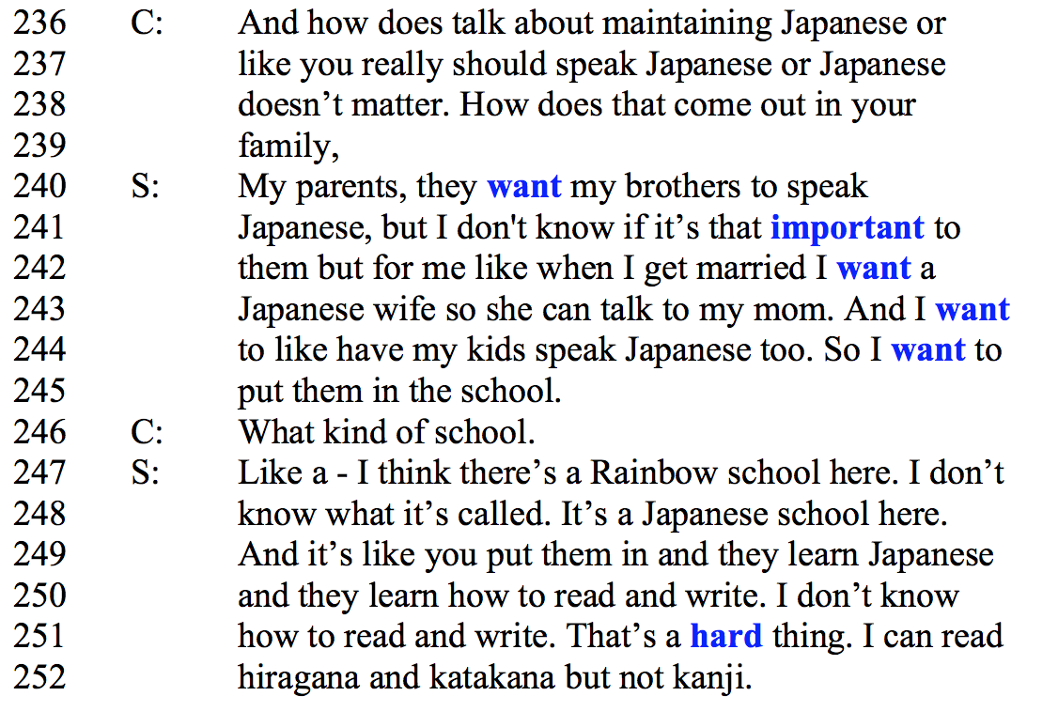
Stance follows showing strong affect
+affect [J] parents, bros.
-apprec [J] bros.
+affect [J] self, fut.wife
+affect [J] fut.kids
+affect [J] fut.kids
-apprec [J] self
Notes:
This excerpt begins when the interviewer, C, asks Seiya directly whether his family talks about maintaining language.
Along the right hand column, you see four instances of positive affect expressed toward Japanese, which as we will see, are ways that Seiya counters the negative appreciation of the language that his brothers and even he has experienced.
In his answer, Seiya voices his parents in line 240. He says, “they want my brothers to speak Japanese” – and yet, his brothers are experiencing language shift to English. Their attitude is represented as “I don’t’ know if that’s important to them” in the form of negative appreciation for Japanese. Nonetheless, his brothers’ stance gives Seiya an opportunity to do his own stance follow, which expresses a great deal of positive affect multiple times.
Seiya’s Japanese maintenance is tied to his current and future identities. He imagines his future wife and kids being able to do the things that he hasn’t been fully able to do himself. This shows up clearly in his desires to send his kids to a Japanese school where they can learn to read and write, a skill he doesn’t have and which he evaluates as a “hard thing”

Slide 17
Parents Brothers
Stance lead
“My parents, they want my brothers to speak Japanese”
"but I don't know if that's important to them”
Alignment
Disalignment
Japanese
"when I get married I want a Japanese wife so she can talk to my mom”
Seiya
Stance follow
Notes:
Here is the stance triangle showing us the effects of appraisals on multiple levels. In the discourse, Seiya’s parents take a stance lead, expressing positive affect through desire about wanting Seiya’s brothers to speak Japanese. Seiya then voices his brother’s lack of appreciation for the language, which is a stance follow that disaligns with his parents. He then follows this stance follow with his own stance follow, expressing the opposite stance. He uses positive affect to align with his parents positive affect, stating “when I get married, I want a Japanese wife so she can talk to my mom.”
The triangle shows how multiple members of families can express differing language attitudes about the same language, and it point to the importance of examining the layered nature of stancetaking in order to understand how totally different valuations of language can take place in a single family.

Slide 18
Seiya (+Jpn) vs. Wally (-Jpn)
Notes:
We find it useful to go back to the quantitative picture of attitude to restate our point that language attitudes are fleeting in the form of discourse, but also that they can accumulate and illuminate the processes leading to language maintenance or language shift.
It’s interesting to note here that Seiya has more positive evaluations overall, which likely contributes to his maintenance of Japanese. On the other hand, Wally has few appraisals in general, which suggests that he may have taken a passive role in stancetaking and in producing stance follows.
Across our data, those who experienced language shift tended to have fewer appraisals compared to those who maintained or revitalized their family’s languages.

Slide 19
HAWAIIAN
2 CASE STUDIES OF STANCETAKING
Shift
Revitalization
Notes:
MONICA
Now we turn to two cases of Hawaiian. First we have a story of language shift, Then, we have a case of revitalization by a young adult whose parents and grandparents do not speak Hawaiian.

Slide 20
Moana’s family tree
Moana’s family tree
Japanese
English
Pidgin
Hawaiian
English
Cantonese
No knowledge
Paternal GF
Paternal GM
Maternal GF
Maternal GM
Cantonese
Pidgin
English
Hawaiian words
English
Pidgin
Hawaiian words
Father
Pidgin
English
Hawaiian words
Mother
MOANA
Pidgin
English
Japanese (school)
Hawaiian (school)
Children

Slide 21
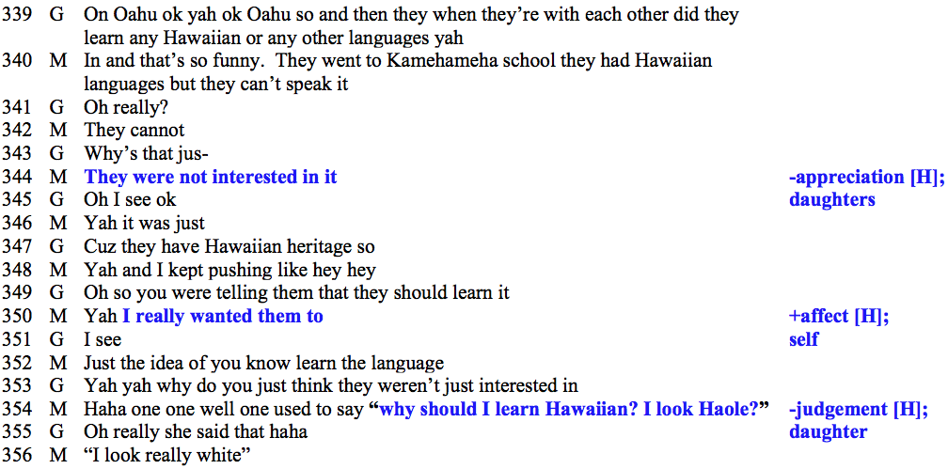
Lack of appreciation and affiliation with Hawaiian
Notes:
Here is an example of how intergenerational language shift takes place due to different stances towards Hawaiian. Along the right hand side, you’ll see negative appraisals by the daughters, with positive affect toward Hawaiian expressed by Moana.
On lines 340-341, Moana says that it’s funny her daughters do not speak Hawaiian despite attending a school for Native Hawaiian children, and she then provides the explanation that “they were not interested in it.” Moana follows this disinterest with “I really wanted them to” (study Hawaiian). Next, Moana voices one of her daughters who said “Why should I learn Hawaiian, I look haole?” (meaning white). This stance follow attributed to her daughter disaligns in a more marked way, and the daughter creates a racialized identity as the reason for not showing interest in the language.

Slide 22
Daughters
Stance lead
“They were not interested”
“Why should I learn Hawaiian, I Iook Haole” …”I look really white”
disalignment
Upgraded disalignment
Hawaiian
“I really wanted them to [learn Hawaiian]”
Stance follow
Moana
Notes:
In terms of the stance triangle, we see the daughter’s negative appraisal here as an upgraded disalignment. The initial stance of the daughters was simply that “they weren’t interested” which points to a lack of internal drive or desire, something that can be changed. However, after Moana expresses that she wants them to learn, her daughter’s response expresses a negative stance toward Hawaiian that is externally-driven and unchangeable.
Moana’s daughter’s stance is embedded in an ideology is that a person cannot and perhaps even should not study Hawaiian if they are not uncontroversially Hawaiian.

Slide 23
Pualei’s family tree
English
Hawaiian
English
English
Pidgin
Paternal grandfather
Paternal grandmother
Maternal grandfather
Maternal grandmother
English
Pidgin
Basic Hawaiian
English
Pidgin
Basic Hawaiian
father
mother
English
Pidgin
Hawaiian
English
Pidgin
Hawaiian
English
Pidgin
Hawaiian
Hawaiian
English
Pidgin
brother
PUALEI
sister
niece
Notes:
Pualei’s generation has made conscious efforts to revitalize the Hawaiian language with the newer members of their generation (little cousins, nieces, etc.).
Pualei’s and her siblings both started taking Hawaiian in their pre-teen years. She and her brother majored In Hawaiian Studies and now as adults, are passing it on to the next generation of her paternal side through FLP where Hawaiian is the language of the home.

Slide 24
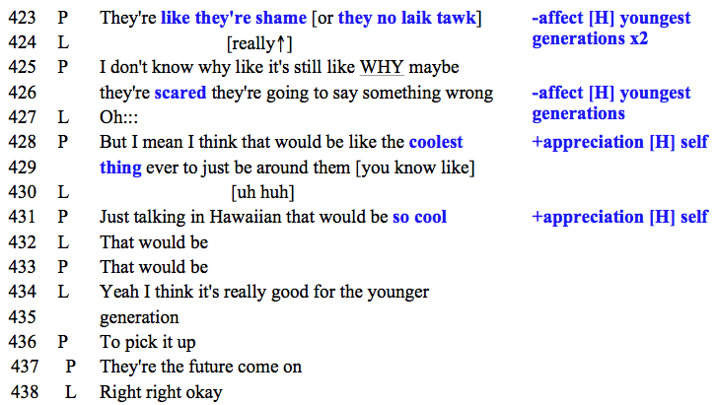
Responding to negative stances of the current generation
Notes:
Along the right hand column, we see negative affect towards Hawaiian by Pualei’s cousins/youngest generations followed by positive attitudes by Pualei.
She is explaining that her cousins/the younger generations of her family feel shame and are scared to speak it, as we see in line 423 and 426. Despite this negative affect, Pualei produces a stance follow that takes a positive view. In line 428 she shows positive appreciation for being around them if they were all speaking Hawaiian with “coolest thing”. And she reiterates the same stance in line 431 stating it would be “so cool”.

Slide 25
Youngest
generations
Stance lead
“They’re like they’re shame”
“They’re scared they’re gonna say something wrong”
Hawaiian
disalignment
“That would be the coolest thing”
“It would be so cool”
Stance follow
Pualei
Notes:
Here we see that Pualei’s stances disalign with the younger generations, who express negative affect in the form of shame and fear about speaking Hawaiian. The result is that Pualei is maintaining a positive view of Hawaiian despite negative sentiments around her, and she is modeling a positive attitude towards Hawaiian (and an identity that shows pride in Hawaiian) to the younger generations that has the potential to be aligned with over the course of time.

Slide 26
Pualei (+Hwn) vs. Moana (-Hwn)
Notes:
Here we return to a quantitative view of the appraisals by Pualei, who has revitalized Hawaiian compared to Moana, who has experienced language shift to English and Pidgin.
On one level, it’s significant that Pualei has more positive evaluations overall, similar to what we saw for Seiya in reference to Japanese. In contrast, and like Wally, Moana has fewer appraisals overall. Moana also has more negative appraisals of the language, which implies that negative language attitudes are part of the explanation of her language shift.
Returning to Pualei - We might wonder why there are so many negative evaluations in her data. But, we also need to recall that in discourse, Pualei responded to negative appraisals by others with positive affect, judgment, and appreciation for Hawaiian. This is not the pattern that we saw in Moana’s discourse.

Slide 27
Selected References
Dubois, J. 2007. The stance triangle. In R. Englebretson (Ed.), Stancetaking in discourse: Subjectivity, evaluation, interaction (pp. 139–182). Amsterdam: John Benjamins.
Hiss, F. 2013. Tromsø as a ‘‘Sámi Town’’? – Language ideologies, attitudes, and debates surrounding bilingual language policies. Language Policy 12, 177-196.
Jaffe, A. (ed.) (2009). Stance: Sociolinguistic perspectives. New York: Oxford University
Press.
Liebscher & Dailey-O’Cain 2009. Language attitudes in interaction. Journal of Sociolinguistics 13(2) 195-222.
Martin, J. R., & White, P. R. R. (2005). The language of evaluation. Appraisal in English. Houndmills, NY: Palgrave Macmillan.

